Slide 1
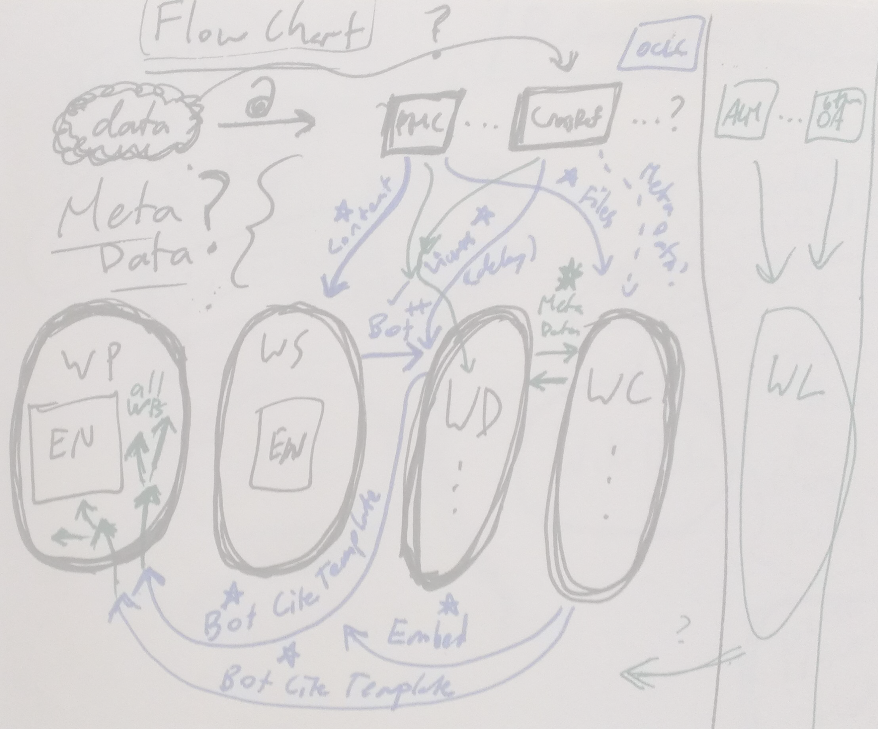
Data-Hacking with Wikimedia Projects:
Learn by Example, Including Wikipedia, Wikidata, and beyond!
@notconfusing (Max Klein)
@wrought (Matt Senate)

Slide 2
Who is in the room?
Data hackers?
Programmers?
Artists/designers?
Open Access folks?
Academics?
Wikipedians?
Wikimedians?
Wiki-people?

Slide 3
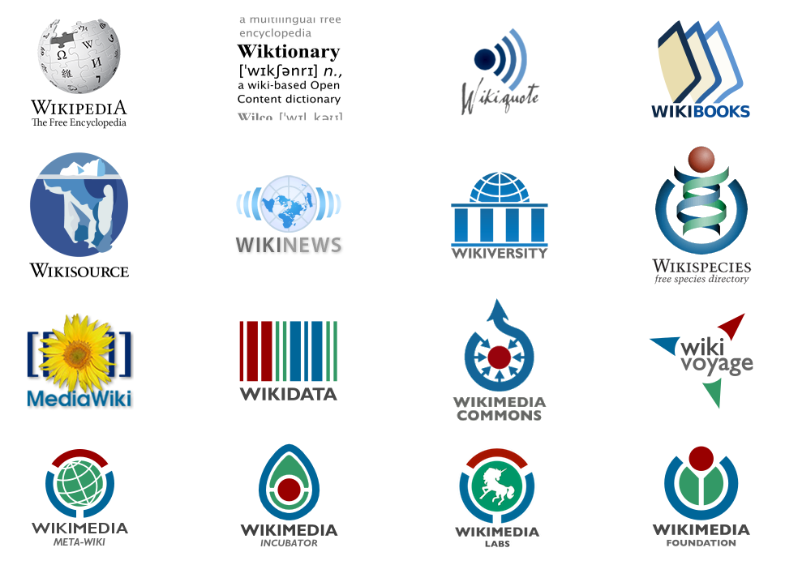
Wikimedia Movement
wikipedia.org
commons.wikimedia.org
wikisource.org
wikidata.org

Slide 4
Wiki Context
Wikipedia: far-largest in size and user base.
Projects often organized by language.
Each language-project has an independent user community.

Slide 5
Wiki Context
See Wikimedia projects as a form of: “curated database”
Web's Least Common Denominator for data.
Wiki Paradox:
Low-barrier-to-entry
High-barrier-to-entry
Buneman, et al. Curated Databases. https://peerlibrary.org/p/rxQ6WBd89XviMF4Tk

Slide 6
How do Wikimedia projects work?
Community
Opt-in
Reputation
Cultural Protocol
Bureaucracy
Adhocracy
Coordination
WikiProjects

Slide 7
History of Wiki Data-Hacking
Rambot
First “bot”
2002
US Census Data
Created 200,000 articles
More than doubled Wikipedia's size at the time
No permissions

Slide 8
“Ignore All Rules” --> Calcification
To get things done:
Need to issue a “Request for Comment” or RFC
Everybody, regardless of expertise has trouble with this.
Sometimes, not everyone is acting in good faith, but try to assume it, it will help.

Slide 9
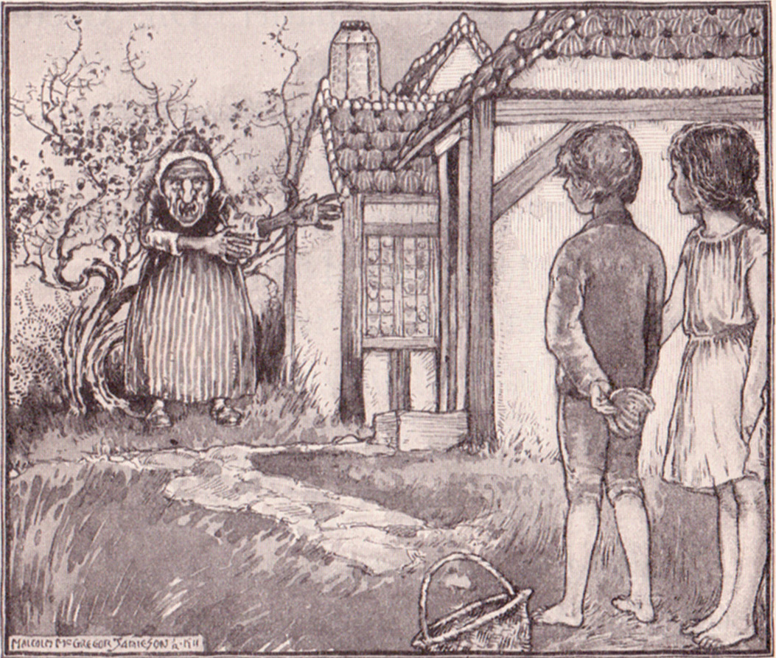
Häskell und Grepl
Hänsel und Gretel
Wikidata
https://commons.wikimedia.org/wiki/File:Hansel_and_Gretel.jpg

Slide 10
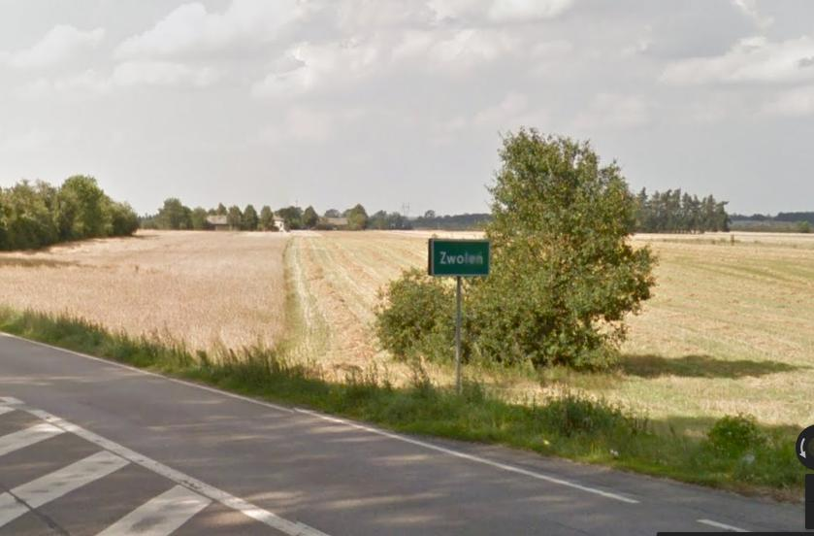
Rural Hunger Problems
The Wikimedia datascape having cross-language data sharing problems.

Slide 11
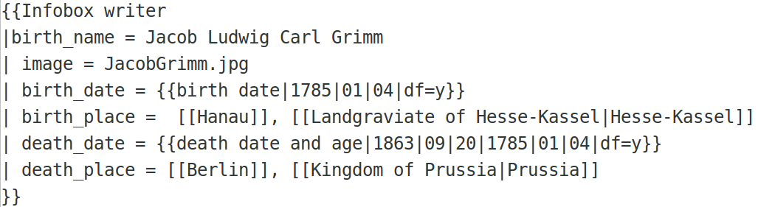
Häskell and Grepl are sent to the Forest alone.
Data is sent to live in Templates, living alone.

Slide 12
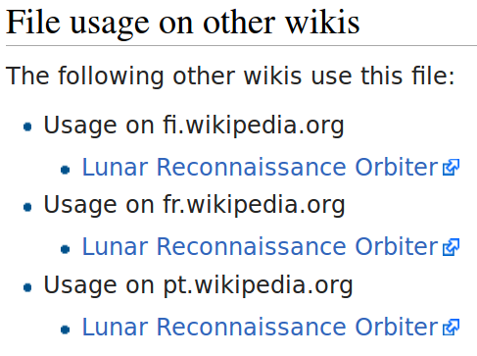
Häskell and Grepl first invent a successful breadcrumb system
Wikimedia commons allows images to be shared across Wikis.

Slide 13
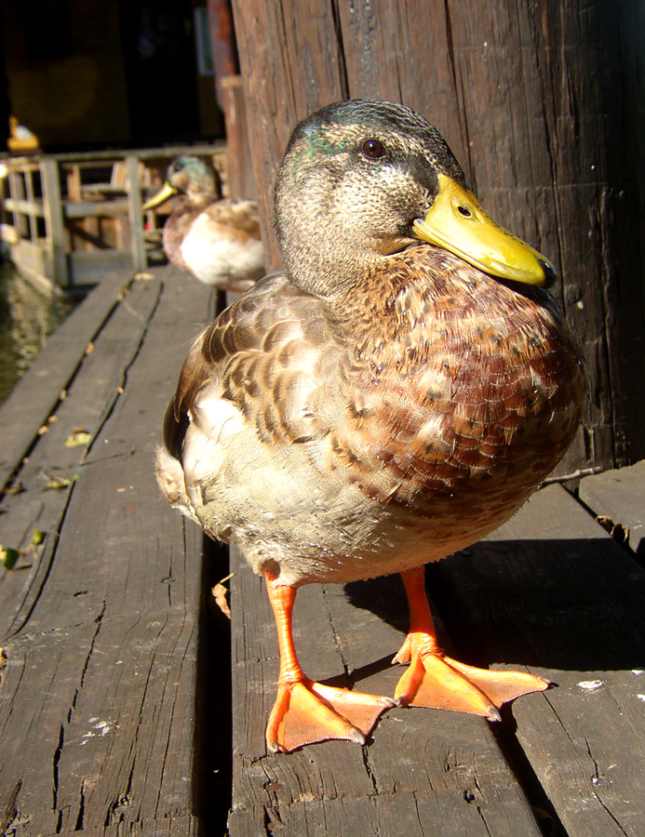
Lucky if their breadcrumbs are not eaten / or whatever put.
Lucky if we knew on which pages the Data was stored.
http://commons.wikimedia.org/wiki/File:Flickr_-_Per_Ola_Wiberg_~_mostly_away_-_-_%22No_bread,_just_a_camera...huh,_quack_%22.jpg

Slide 14
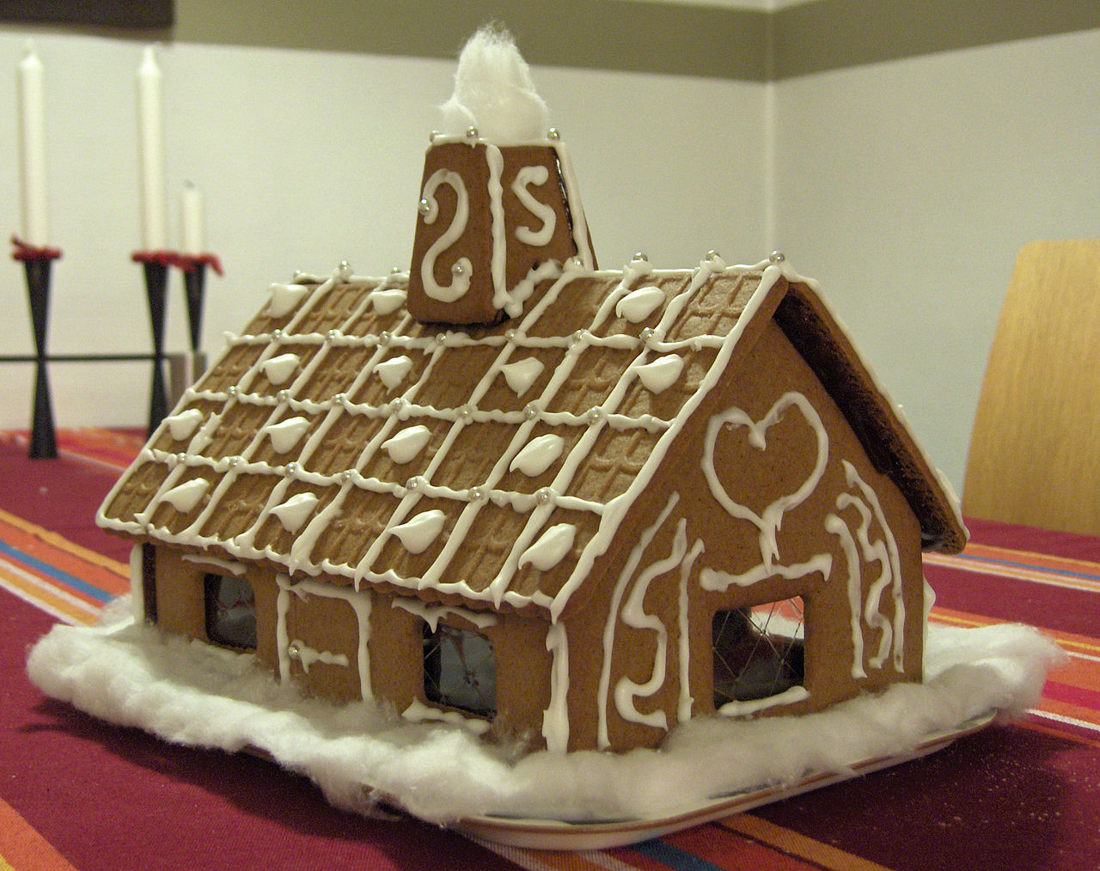
A magical gingerbread house
A magical data store
Called “Wikidata”
Interwiki data sharing
Plus with extra sweeties
http://commons.wikimedia.org/wiki/Gingerbread_house#mediaviewer/File:Pepparkakshus.JPG

Slide 15
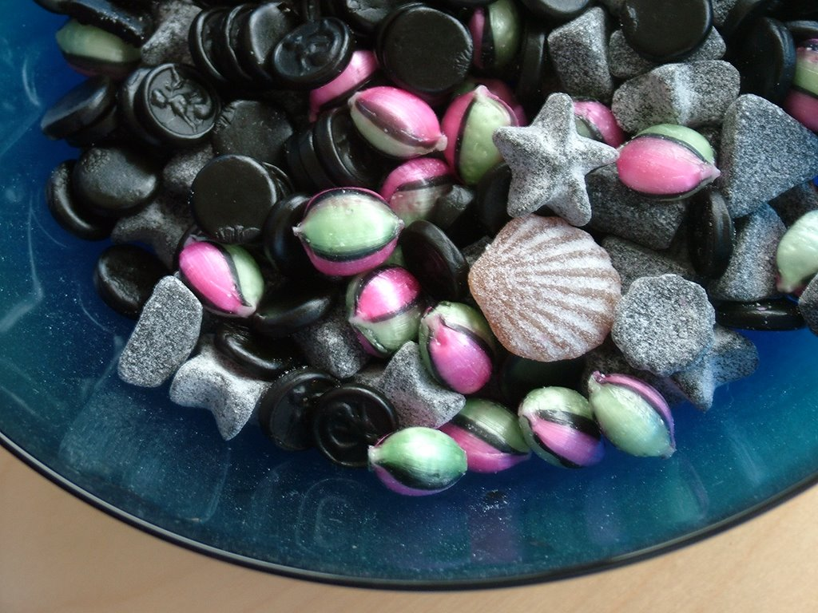
And the house includes many different sweeties.
Semantic Triples
Qualifiers
Ranks
http://commons.wikimedia.org/wiki/Category:Liquorice_candy#mediaviewer/File:Flickr_-_cyclonebill_-_Slik_%281%29.jpg

Slide 16
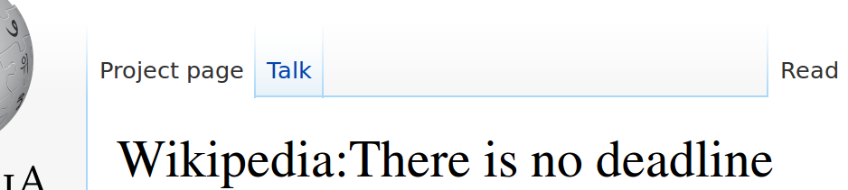
Häskell and Grepl eat the roof hungrily.
In this story, the User's start adding to Wikidata.
Importing Wikipedia
Foreign Database
Manual adds.

Slide 17
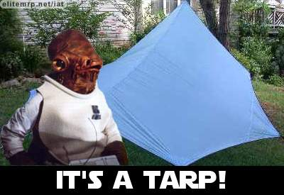
The evil witch trap
The evil data witches, normally keep the information as a silo.

Slide 18

Grepl's cunning defeat of the witch
Identifers
Think of this as a foreign database key (Brian Jacobs)
Max imported 400,000 biographical identifers.
This started an Identiifer craze on Wikidata
Tennis Player
Swiss Parliament
Danish Companies

Slide 19
Grepl's cunning defeat of the witch
All Wikis can transclude arbitrary data (eventually).
And Citations can be represented as semantic properties.
See how sources are handled with “FRBR” format: http://www.wikidata.org/wiki/Help:Sources#Scientific.2C_newspaper_or_magazine_article

Slide 20
Signalling Open Access
WikiProject Open Access
On English Wikipedia
(Data) Problem: Signalling “Open Access” is hard!
Solution: Use clear signals directly to the relevant data.
Copyright license
Source content
Metadata

Slide 21
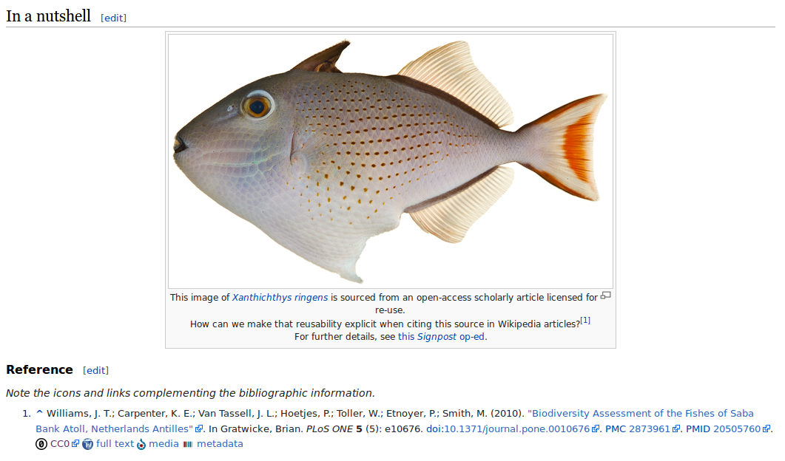
What?

Slide 22
How?
Text → WikiSource
Media → Commons
Metadata → Wikidata
Signals → Wikipedia
Including license!
Public domain, CC0, CC-BY, CC-BY-SA, etc
RFC → RecitationBot
RFC → RecitationBot
RFC → RecitationBot
RFC → RecitationBot

Slide 23
In the Wikimedia Universe
Where does “Signalling Open Access” fit in the Wikimedia narrative?
(Data) Problem: Managing citations & references is hard!
Possible Solutions:
Templates (Many)
Categories (Many)
Namespace (FR)
WikiScholar (Dead)
VisualEditor (Zotero?)

Slide 24
“Signalling OA” Opportunities
Take pass at citation management
Quality & experience
Integrate metadata with Wikidata
Where it belongs
Sensitivity and rigor
Forge deep knowledge resources on Wikipedia
Snapshots of sources, deeper linking
Automate, but use human judgment
Save time and energy, improve accuracy.

Slide 25
Paths for Data Hackers
Reputation
Create a user account
Contribute in good faith to wikimedia projects
Cultural protocol
Identify the scope, concerns, and nature of a given project
Learn to navigate
History and Context
Form a narrative for your hack based on past endeavors
Seek consent and build consensus
Community
Reach out, on IRC and mailing lists!

Slide 26
Of course we're Open Source github.com/wpoa/OA-signalling
github.com/wpoa/recitation-bot
Thanks!
@notconfusing (Max)
@wrought (Matt)

